Slide 1
Unit III: Classes and Objects

Slide 2
Java -Methods
Syntax
modifier returnType nameOfMethod (Parameter List)
{
// method body
}
public static int methodName(int a, int b)
{
// body
}
Here,
• public static − modifier
• int − return type
• methodName − name of the method
• int a, int b − list of parameters

Slide 3
Java -Methods
Call by Value and Call by Reference in Java
There is only call by value in java, not call by reference.
class Operation
{
int data=50;
void change(int data)
{
data=data+100; //changes will be in the local variable only
}
public static void main(String args[])
{
Operation op=new Operation();
System.out.println("before change "+op.data);
op.change(500);
System.out.println("after change "+op.data);
}
}

Slide 4
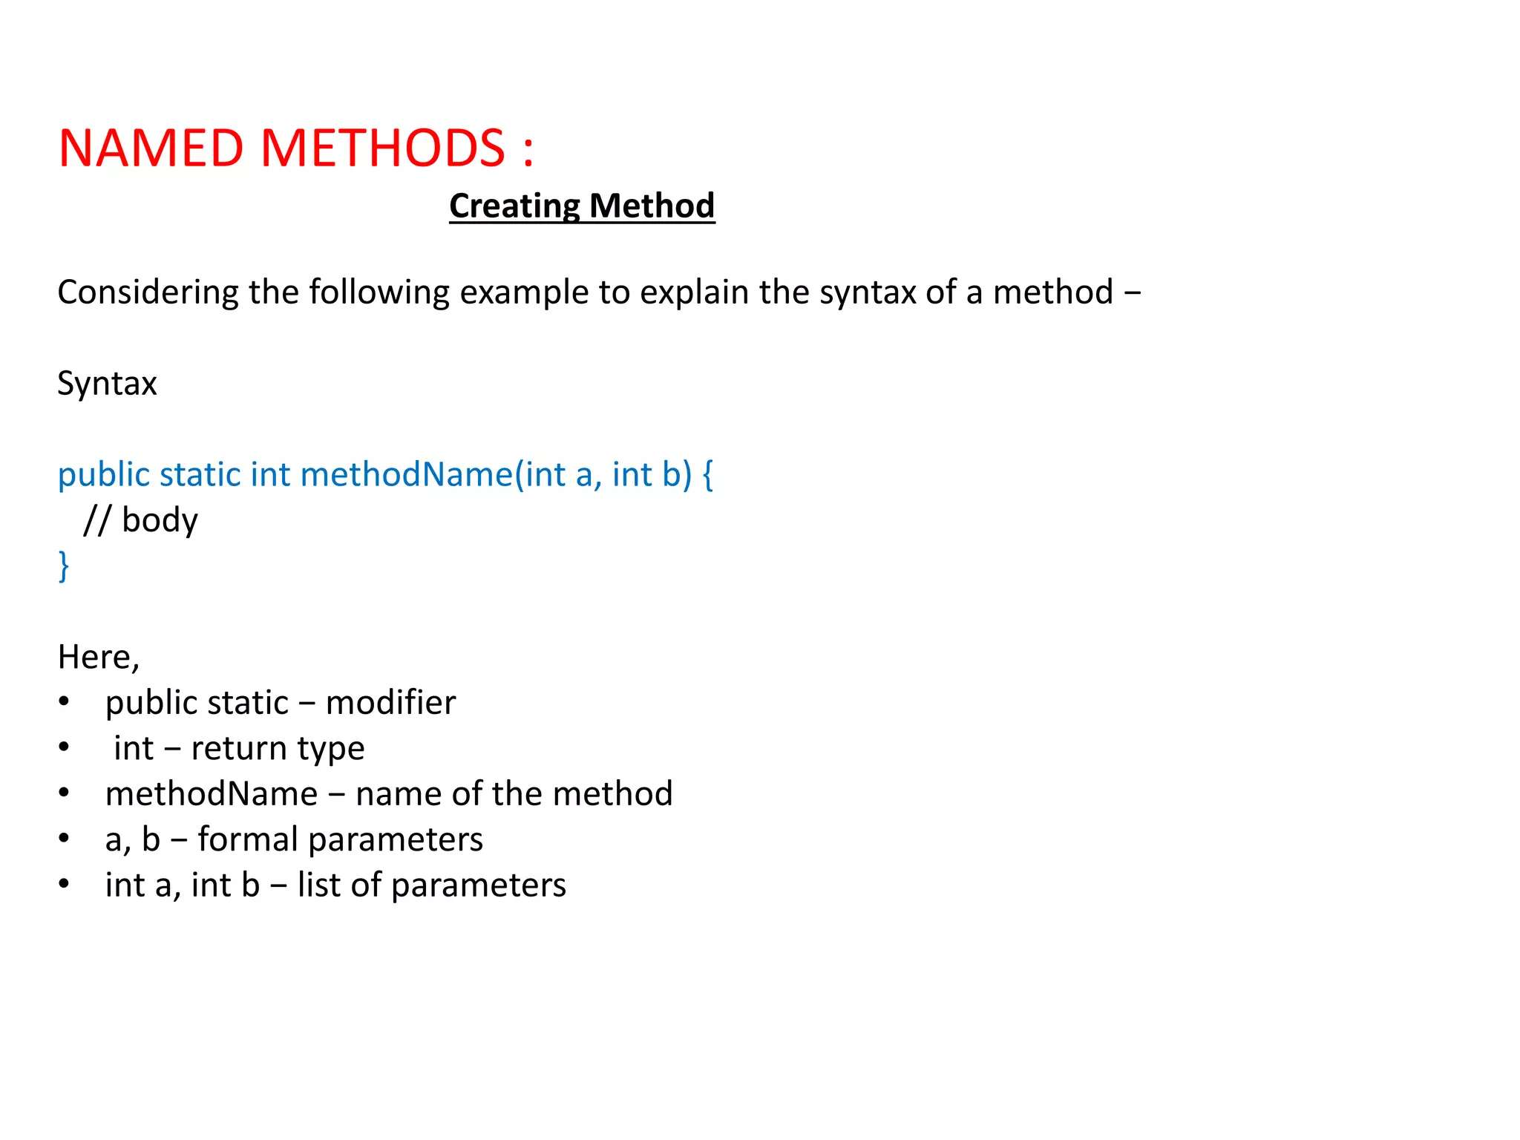

Slide 5
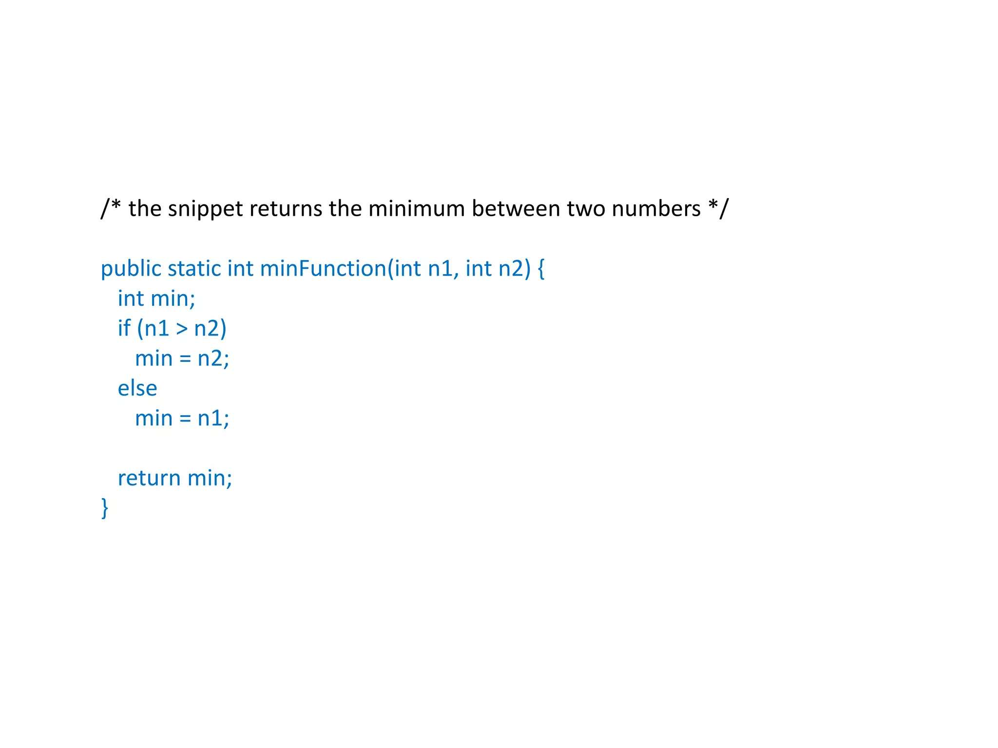

Slide 6
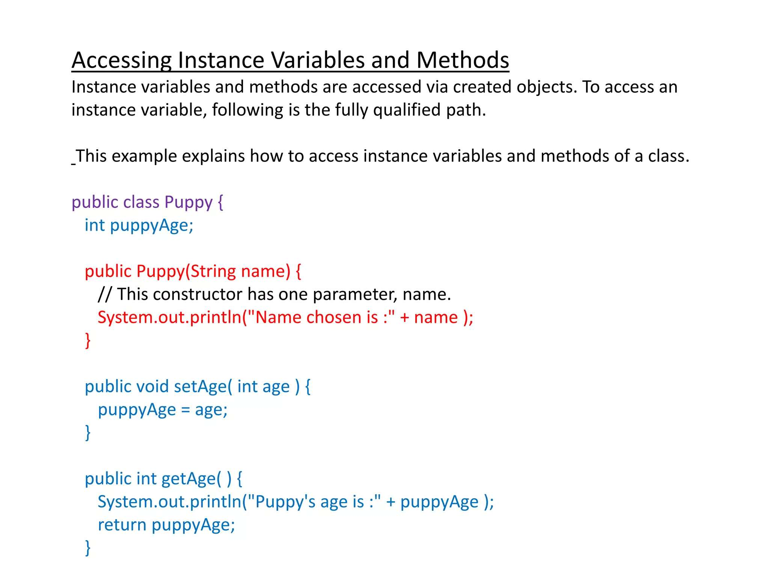

Slide 7
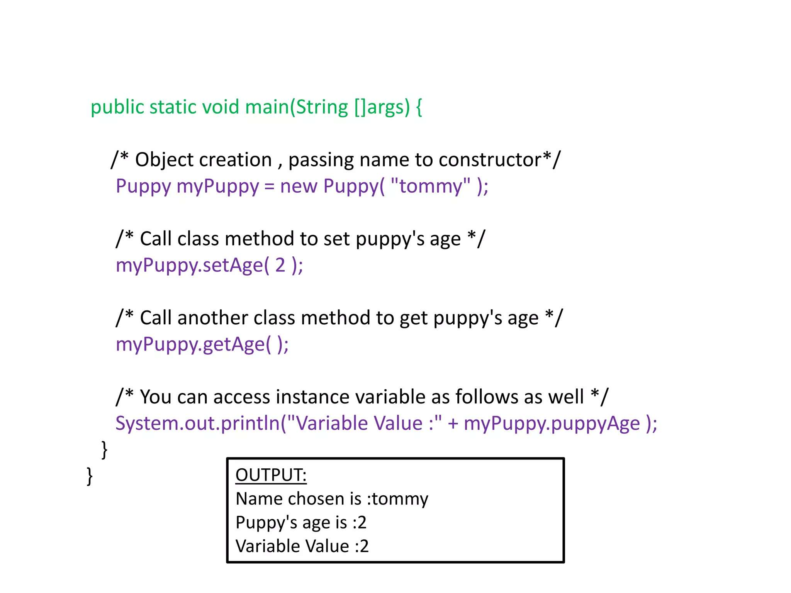

Slide 8
Static Fields and Methods
Static Fields and Methods
The static keyword in java is used for memory management mainly.
The static keyword belongs to the class than instance of the class.
The static can be:
1. variable (also known as class variable)
2. method (also known as class method)
3. block
4. nested class

Slide 9
Java static variable
If you declare any variable as static, it is known static variable.
The static variable can be used to refer the common property of all objects (that is not unique for each object) e.g. company name of employees,college name of students etc.
The static variable gets memory only once in class area at the time of class loading.
It makes your program memory efficient (i.e it saves memory).
class Student8
{
int rollno;
String name;
static String college ="ITS";
Student8(int r,String n)
{
rollno = r;
name = n;
}
void display ()
{
System.out.println(rollno+" "+name+" "+college);
}
public static void main(String args[])
{
Student8 s1 = new Student8(111,"Karan");
Student8 s2 = new Student8(222,"Aryan");
s1.display();
s2.display();
}
} //class ends

Slide 10
Java static method
A static method belongs to the class rather than object of a class.
A static method can be invoked without the need for creating an instance of a class.
static method can access static data member and can change the value of it.
class Student9
{
int rollno;
String name;
static String college = "ITS";
static void change()
{
college = "BBDIT";
}
Student9(int r, String n)
{
rollno = r;
name = n;
}
void display ()
{
System.out.println(rollno+" "+name+" "+college);
}
public static void main(String args[])
{
Student9 s1 = new Student9(111,"Karan");
Student9 s2 = new Student9(222,"Aryan");
s1.display();
s2.display();
}
} //class ends

Slide 11
Java static block
Is used to initialize the static data member.
It is executed before main method at the time of class loading.
class A2
{
static
{
System.out.println("static block is invoked");
}
public static void main(String args[])
{
System.out.println("Hello main");
}
}

Slide 12
Access Modifiers in java
There are 4 types of java access modifiers:
1. private
2. default
3. protected
4. public

Slide 13
Access Modifiers in java
private access modifier
The private access modifier is accessible only within class.
class A
{
private int data=40;
private void msg()
{
System.out.println("Hello java");
}
}
public class Simple
{
public static void main(String args[])
{
A obj=new A();
System.out.println(obj.data);//Compile Time Error
obj.msg();//Compile Time Error
}
}

Slide 14
Access Modifiers in java
default access modifier
If you don't use any modifier, it is treated as default by default.
The default modifier is accessible only within package.
Packages are a mechanism that encapsulates a group of classes, sub-packages, and interfaces.
//save by A.java
package pack;
class A
{
void msg()
{
System.out.println("Hello");
}
}
//save by B.java
package mypack;
import pack.*;
class B
{
public static void main(String args[])
{
A obj = new A(); //Compile Time Error
obj.msg(); //Compile Time Error
}
}

Slide 15
Access Modifiers in java
protected access modifier
is accessible within package and outside the package but through inheritance only.
The protected access modifier can be applied on the data member, method and constructor. It can't be applied on the class.
//save by A.java
package pack;
public class A //Parent Class
{
protected void msg()
{
System.out.println("Hello");
}
}
//save by B.java
package mypack;
import pack.*;
class B extends A //Child Class or Subclass
{
public static void main(String args[])
{
B obj = new B();
obj.msg();
}
}

Slide 16
Access Modifiers in java
public access modifier
accessible everywhere.
It has the widest scope among all other modifiers.
//save by A.java
package pack;
public class A
{
public void msg()
{
System.out.println("Hello");
}
}
//save by B.java
package mypack;
import pack.*;
class B
{
public static void main(String args[])
{
A obj = new A();
obj.msg();
}
}

Slide 17
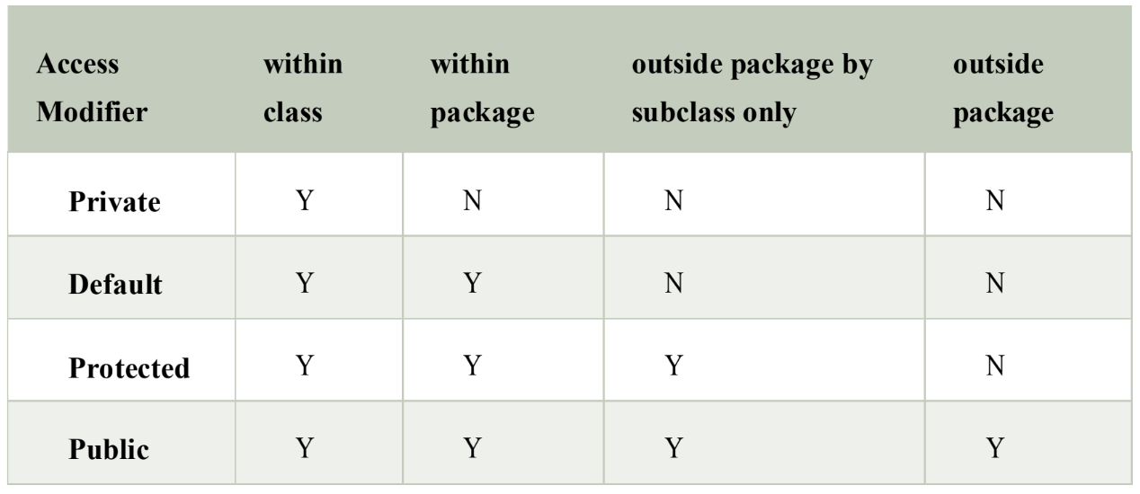
Understanding all java access modifiers

Slide 18
Java Console Class
Used to get input from console.
It provides methods to read texts and passwords.
If you read password using Console class, it will not be displayed to the user.
The java.io.Console class is attached with system console internally.
import java.io.Console;
class ReadStringTest
{
public static void main(String args[])
{
Console c=System.console();
System.out.println("Enter your name: ");
String n=c.readLine();
char[ ] p=c.readPassword();
System.out.println("Welcome "+n);
}
}

Slide 19
Java Console Class
Console Class Methods | Description
Reader reader() | It is used to retrieve the reader object associated with the console
String readLine() | It is used to read a single line of text from the console.
String readLine(String fmt, Object... args) | It provides a formatted prompt then reads the single line of text from the console.
char[] readPassword() | It is used to read password that is not being displayed on the console.
char[] readPassword(String fmt, Object... args) | It provides a formatted prompt then reads the password that is not being displayed on the console.
Console format(String fmt, Object... args) | It is used to write a formatted string to the console output stream.
Console printf(String format, Object... args) | It is used to write a string to the console output stream.
PrintWriter writer() | It is used to retrieve the PrintWriter object associated with the console.
void flush() | It is used to flushes the console.

Slide 20
Java Scanner Class
A class in java.util package used for obtaining the input of the primitive types like int, double, etc. and strings.
Using the Scanner class in Java is the easiest way to read input in a Java program
import java.util.Scanner;
class ReadStringTest
{
public static void main(String args[])
{
Scanner sc = new Scanner(System.in);
System.out.println("Enter your name: ");
String name = sc.nextLine();
System.out.println("Welcome "+name);
}
}

Slide 21
Java Scanner Class
Scanner Class Methods | Description
nextBoolean() | Used for reading Boolean value
nextByte() | Used for reading Byte value
nextDouble() | Used for reading Double value
nextFloat() | Used for reading Float value
nextInt() | Used for reading Int value
nextLine() | Used for reading Line value
nextLong() | Used for reading Long value
nextShort() | Used for reading Short value

Slide 22
Recursion in Java
Recursion in java is a process in which a method calls itself continuously.
A method in java that calls itself is called recursive method.
public class RecursionExample3
{
static int factorial(int n)
{
if (n == 1)
return 1;
else
return(n * factorial(n-1));
}
public static void main(String[] args)
{
System.out.println("Factorial of 5 is: "+factorial(5));
}
}

Slide 23
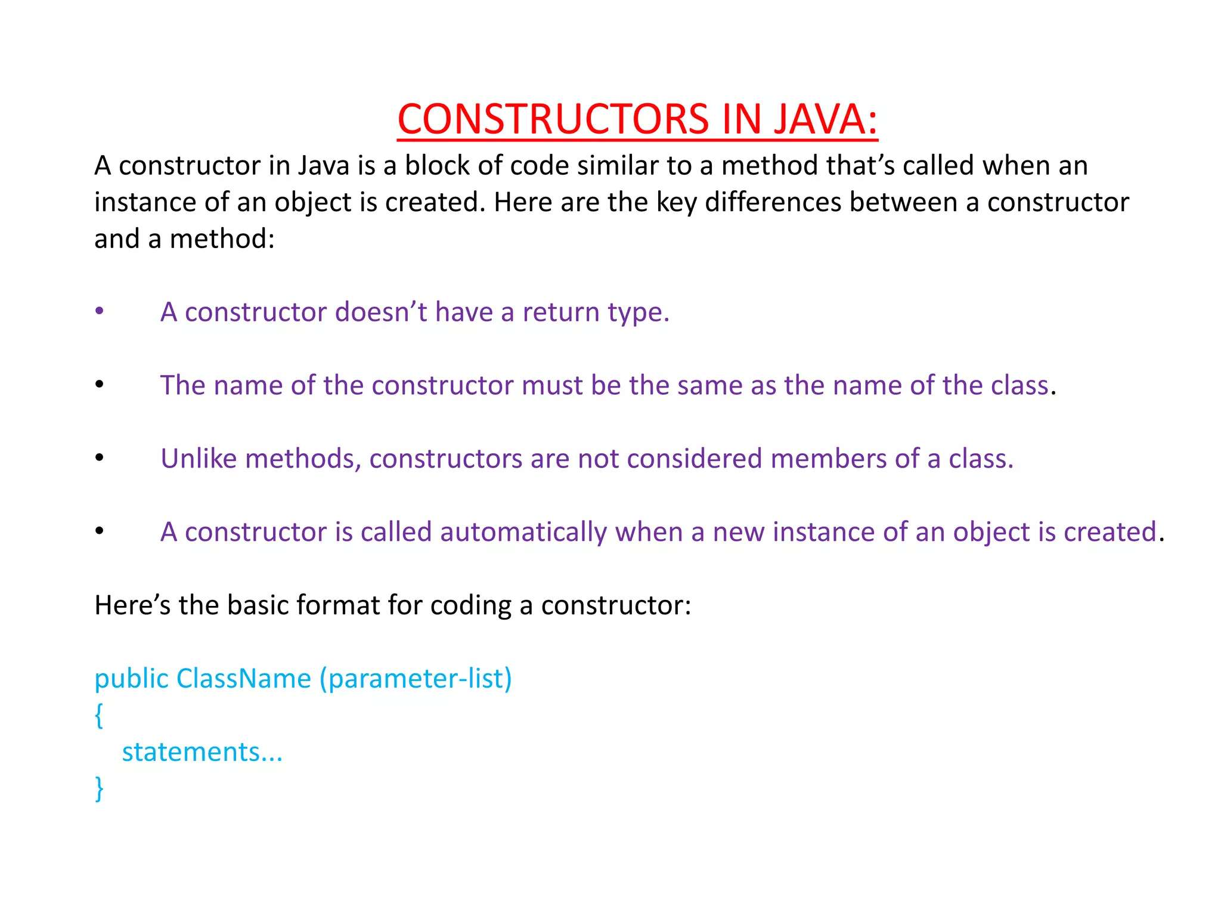

Slide 24
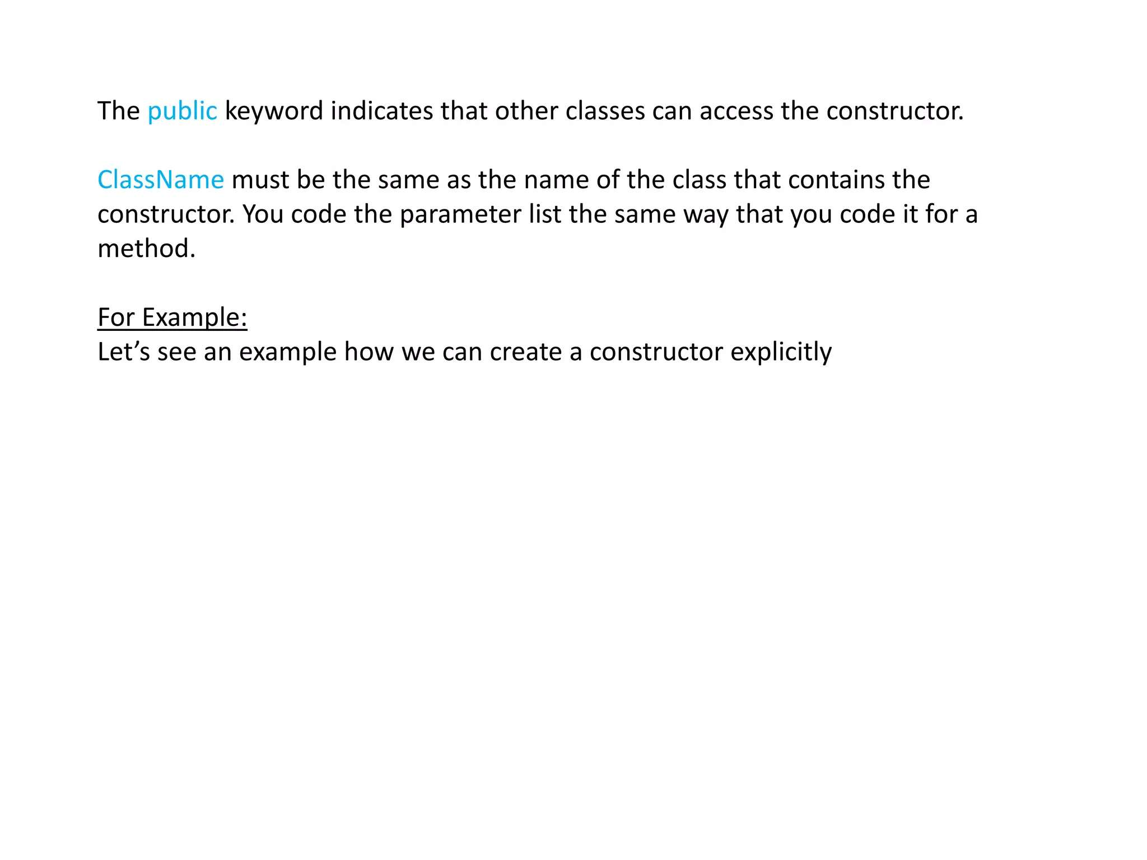

Slide 25
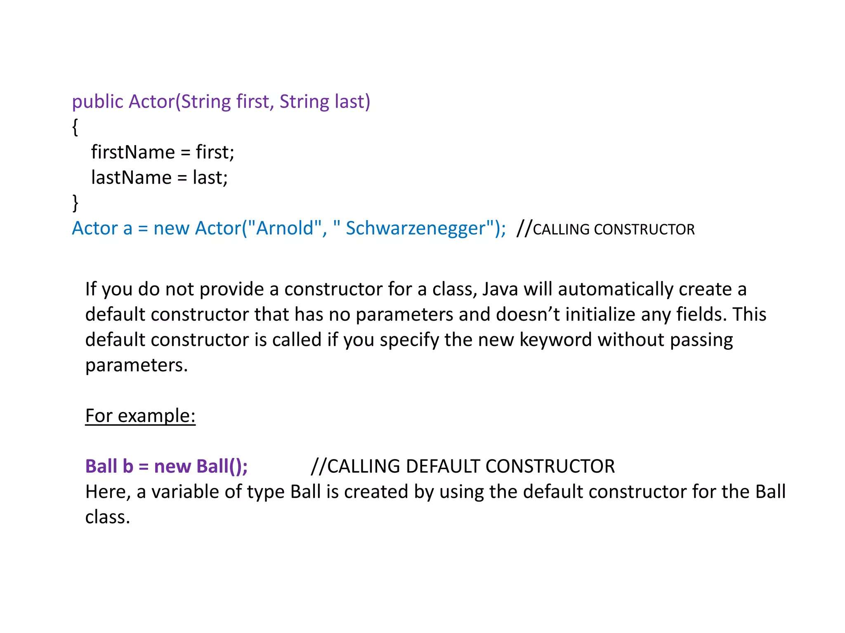

Slide 26
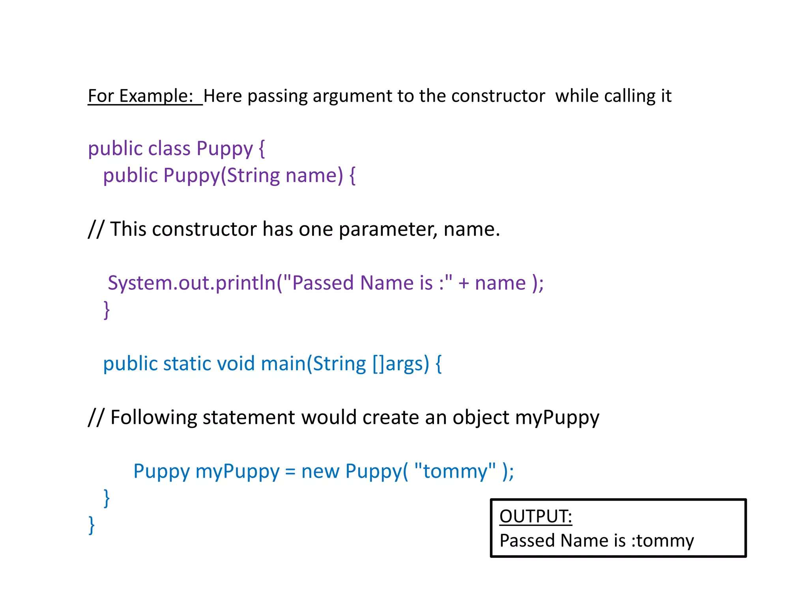

Slide 27
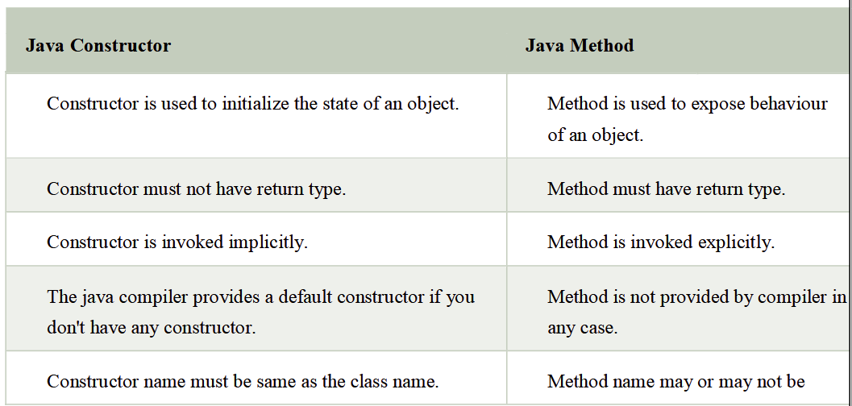
Difference between constructor and method in java

Slide 28
Constructor Overloading in Java
A technique in Java in which a class can have any number of constructors that differ in parameter lists.
The compiler differentiates these constructors by taking into account the number of parameters in the list and their type.
class Student5{
int id;
String name;
int age;
Student5(int i,String n){
id = i;
name = n;
}
Student5(int i,String n,int a){
id = i;
name = n;
age=a;
}
void display()
{System.out.println(id+" "+name+" "+age);}
public static void main(String args[])
{
Student5 s1 = new Student5(111,"Karan");
Student5 s2 = new Student5(222,"Aryan",25);
s1.display();
s2.display();
}
}

Slide 29
Method Overloading in java- Polymorphism
If a class has multiple methods having same name but different in parameters, it is known as Method Overloading.
Ways to Overload Methods in Java:
By Changing the Number of Parameters
By Changing the Data Type of Parameters
By Changing the Order of Parameters

Slide 30
Method Overloading in java- Polymorphism
By Changing the Number of Parameters
class Adder
{
static int add(int a,int b)
{
return a+b;
}
static int add(int a,int b,int c)
{
return a+b+c;
}
}
class TestOverloading1
{
public static void main(String[] args)
{
System.out.println(Adder.add(11,11));
System.out.println(Adder.add(11,11,11));
}
}

Slide 31
Method Overloading in java- Polymorphism
By Changing the Data Type of Parameters
class Adder
{
static int add(int a,int b)
{
return a+b;
}
static double add(double a,double b)
{
return a+b+c;
}
}
class TestOverloading1
{
public static void main(String[] args)
{
System.out.println(Adder.add(11,11));
System.out.println(Adder.add(11.00,11.00));
}
}

Slide 32
Method Overloading in java- Polymorphism
By Changing the Order of Parameters
class Adder
{
static int add(int a,double b)
{
return a+b;
}
static double add(double b,int a)
{
return a+b+c;
}
}
class TestOverloading1
{
public static void main(String[] args)
{
System.out.println(Adder.add(11,11.00));
System.out.println(Adder.add(11.00,11));
}
}

Slide 33
Java Copy Constructor- Object Cloning
A copy constructor is a type of constructor that creates an object using another object of the same class.
There is no copy constructor in java. But, we can copy the values of one object to another like copy constructor in C++.
There are many ways to copy the values of one object into another in java. They are:
By constructor
By assigning the values of one object into another
By clone() method of Object class
class Student6{
int id;
String name;
Student6(int i,String n){
id = i;
name = n;
}
Student6(Student6 s){
id = s.id;
name =s.name;
}
void display(){System.out.println(id+" "+name);}
public static void main(String args[])
{
Student6 s1 = new Student6(111,"Karan");
Student6 s2 = new Student6(s1);
s1.display();
s2.display();
}
}

Slide 34
‘this’ reference in Java
In Java, ‘this’ is a reference variable that refers to the current object, or can be said “this” in Java is a keyword that refers to the current object instance.
It can be used to call current class methods and fields, to pass an instance of the current class as a parameter, and to differentiate between the local and instance variables.
Using “this” reference can improve code readability and reduce naming conflicts.
public class Person {
String name;
int age;
Person(String name, int age) {
this.name = name;
this.age = age;
}
public String get_name() { return name; }
public void change_name(String name) {
this.name = name;
}
public void printDetails() {
System.out.println("Name: " + this.name);
System.out.println("Age: " + this.age);
System.out.println();
}
public static void main(String[] args) {
Person first = new Person("ABC", 18);
Person second = new Person("XYZ", 22);
first.printDetails();
second.printDetails();
first.change_name("PQR");
System.out.println("Name has been changed to: " + first.get_name()); }}

Slide 35
Array of Objects in Java
To store multiple instances of a class within a single array.
To easily manage a collection of objects when working with large datasets or collections.
1. Declaration: To declare an array of objects, specify the class name followed by square brackets [].
Class_Name[ ] objectArrayReference;
Student[] students;
Alternatively, we can also declare an Array of Objects as,
Class_Name objectArrayReference[ ];
Student students[];
2. Instantiation: After declaring the array, instantiate it using the new keyword, specifying the size of the array.
Class_Name obj[ ]= new Class_Name[Array_Length];
students = new Student[3]; // An array of 3 Student objects
3. Initialization: Each element of the array must be initialized individually, either via constructor or setter methods.

Slide 36
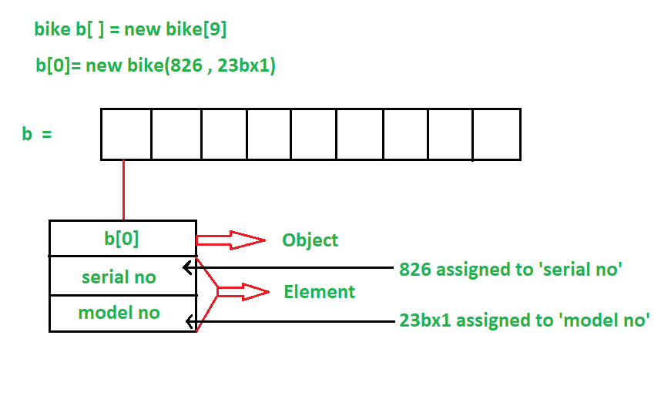
Array of Objects in Java
Structure of an Array Objects:

Slide 37
Array of Objects in Java
Initializing Array Of Objects using the constructor
class Student {
int id;
String n;
Student(int id, String n) {
this.id = id;
this.n = n;
}
void display() {
System.out.println("ID: " + id + ", Name: " + n);
}
}
public class Main {
public static void main(String[] args) {
Student[ ] s = {
new Student(1, "Ram"),
new Student(2, "Shyam")
};
for (Student s1 : s) {
s1.display();
}
}
}

Slide 38
Array of Objects in Java
Initializing Array Of Objects using the setter method
class Student {
public int id;
public String n;
public void setData(int id, String n) {
this.id = id;
this.n = n;
}
public void display() {
System.out.println("Student id is: " + id + " "
+ "and Student name is: "
+ n);
System.out.println();
}
}
public class Main {
public static void main(String args[]) {
Student[] arr = new Student[2];
arr[0] = new Student();
arr[1] = new Student();
arr[0].setData(1, "Sai");
arr[1].setData(2, "Omm");
System.out.println(
"Student data in student arr 0: ");
arr[0].display();
System.out.println(
"Student data in student arr 1: ");
arr[1].display();
}
}

Slide 39
Passing and Returning Objects in Java
Although Java is strictly passed by value
But when we pass an object to a method, objects are passed by what is effectively call-by-reference (hybrid between pass-by-value and pass-by-reference).
class Person {
String name;
Person(String name) {
this.name = name;
}
public static void modifyName(Person p) {
p.name = "Ram Kumar";
}
}
public class ObjectPassingExample {
public static void main(String[] args) {
Person person = new Person("Ravi");
System.out.println("Before modification: " + person.name);
person.modifyName(person);
System.out.println("After modification: " + person.name);
}
}

Slide 40
Passing Objects through Constructors - Object Cloning
when we need to create a new object with the identical initial state as an existing object.
Define a constructor that takes an object of the class as an argument.
class Box {
double boxWidth, boxHeight, boxDepth;
Box(Box otherBox) {
boxWidth = otherBox.boxWidth;
boxHeight = otherBox.boxHeight;
boxDepth = otherBox.boxDepth;
}
Box(double width, double height, double depth) { boxWidth = width;
boxHeight = height;
boxDepth = depth;
}
double calculateVolume() {
return boxWidth * boxHeight * boxDepth;
} }
public class ModifiedObjectInitialization {
public static void main(String args[]) {
Box originalBox = new Box(10, 15, 25);
Box clonedBox = new Box(originalBox);
double volume;
volume = originalBox.calculateVolume();
System.out.println("Volume of originalBox is " + volume);
volume = clonedBox.calculateVolume();
System.out.println("Volume of clonedBox is " + volume);
}
}

Slide 41
Passing and Returning Objects in Java
Returning Objects
class ObjectReturnDemo {
int a;
ObjectReturnDemo(int i) { a = i; }
ObjectReturnDemo incrByTen()
{
ObjectReturnDemo temp
= new ObjectReturnDemo(a + 10);
return temp;
}
}
public class ObjectReturningExample
{
public static void main(String args[])
{
ObjectReturnDemo ob1 = new ObjectReturnDemo(2);
ObjectReturnDemo ob2;
ob2 = ob1.incrByTen();
System.out.println("ob1.a: " + ob1.a);
System.out.println("ob2.a: " + ob2.a);
}
}

